Slide 1

DATA SCIENCE
Prof. Jean Paul Barddal

Slide 2
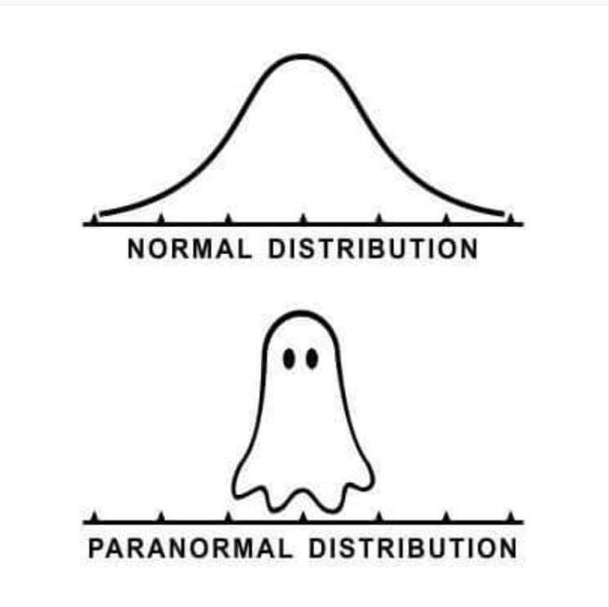
(BASIC) STATISTICS

Slide 3
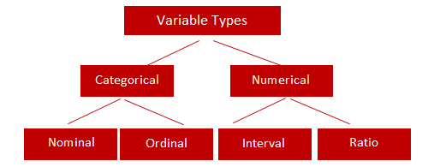
Types of variables
There are many taxonomies for variables.
In this module, we will follow a simple, yet robust categorization:

Slide 4
Types of Variables
Numeric
Interval
Monetary amounts, temperature in Celsius or Fahrenheit, IQ values, etc
Ratio
Same as above, but the 0 (zero) value has a special meaning
Height, weight, temperature in Kelvin (none can be negative! – and somes, even zero!)
Categorical
Nominal
Gender (M/F), Nationality, Car make (all values share the same importance)
Ordinal
Hotel ratings (number of stars), movie ratings (poor, bad, good, great)

Slide 5
Population versus sample
Population
CENSUS
(N elements)
Sample
(n elements)
Sampling
Statistical inference

Slide 6
Population versus sample
Population: set of individuals with at least one common observable trait
If we can survey everyone: CENSUS
Otherwise, we survey a finite subset of the population: SAMPLE
X₁
X₂
X₃
...

Slide 7
Sampling
Process used to derive a sample
If the sample is good enough, we can estimate reliable characteristics of the population
Why do we sample?
Population can be infinite!
Decreasing data acquisition costs

Slide 8
How do we sample?
The sample size depends on:
...data variability (greater variance ⇨ greater n)
...of the precision required (greater precision ⇨ greater n)
...the time available (less time ⇨ smaller n)
...the sampling cost (higher cost ⇨ smaller n)

Slide 9
Sample representativity
Sample randomness
The key is to guarantee that every individual from the population has a chance of participating of the sample
Non-biased sampling
The only way to generalize the results from the sample to the entire population

Slide 10
Sampling methods
PROBABILISTIC
Each population member has the same (non-null) probability of being selected to the sample
NON PROBABILISTIC
Sampling is restricted to elements that we have access to (ex: chemical dependants in treatment)
Impossibility of sampling (ex: blood test)
Volunteering (ex: vaccine and/or medication testing)

Slide 11
Simple random sampling
Simplest method
You pick n elements from a population of size N (with or without replacement)

Slide 12
Systematic sampling
Sampling is done uniformly over the population
If the population elements are sorted according to some criteria, they can be selected according to some “step”
1
10
20
step = 5

Slide 13
Stratified sampling
Can generate samples that are very precise
Used for heteregoneous populations with homogeneous strata
The population (N) is divided in L subpopulations (strata) with N1, N2, ..., NL, elements. In each stratum, ni elements are picked randomly, and the sum of nis totalize n elements

Slide 14
Reminder
Most part of the datasets we will work with are samples that represent behaviors we observe in the real world
In machine learning, our goal is to generalize the behavior observed in samples via machine learning, and use the model to predict the behavior of unseen examples accurately

Slide 15
Descriptive statistics
Goal: summarize and describe a dataset
Main statistics:
Mean
Mode
Median
Quartiles and Percentiles
Variance
Standard deviation

Slide 16
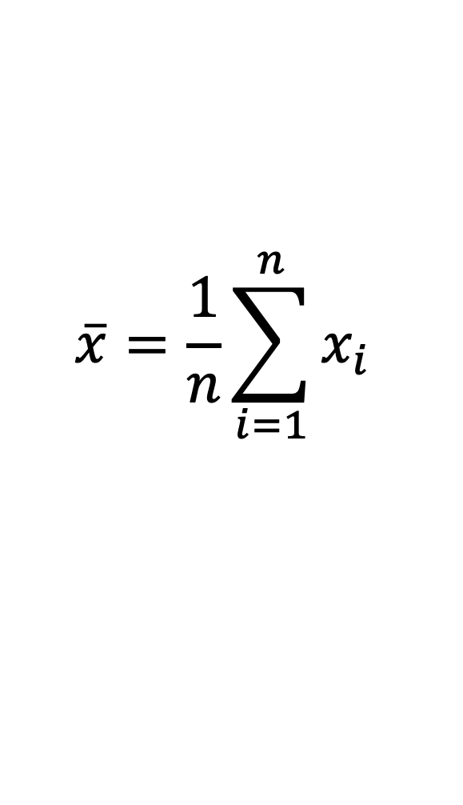
Mean
Summation of all the data, divided by the number of elements
$$\overline{x}=\frac{1}{n}\sum_{i=1}^{n}{x_{i}}$$
By far, the most used statistic
The mean, is possibly a value that does not belong to the sample

Slide 17
Mode
The most frequent value in the data
What is the mode in the following lists?
[1, 1, 2, 3, 4]
[1, 2, 3, 4, 5, 6, 7, 8, 9, 10]
[1, 1, 1, 2, 2, 2, 3, 4, 5]

Slide 18
Median
Given a sorted dataset, the median occupies the central position of the list
Example:
[32, 33, 24, 31, 44, 65, 32, 21, 32]
Sorting:
[21, 24, 31, 32, 32, 32, 33, 44, 65]
Median:
[21, 24, 31, 32, 32, 32, 33, 44, 65]

Slide 19
Median
If the dataset has an even number of elements, the median is usually the mean of the two most central values
Example:
[18, 19, 19, 22, 44, 45, 46, 46, 47, 48]
Median = (44+45)/2 = 44,5

Slide 20
Quartiles and Percentiles
Quartiles divide the data in 4 parts. These are indicated by Q1, Q2 and Q3, such that Q2 is the median
The same rationale can be applied to percentiles, that divide the data in each 1%: P1, P2, P3, … P99
Q1 = 19
Q3=46
[18, 19, 19, 22, 44, 45, 46, 46, 47, 48]
Q2 = 44,5

Slide 21
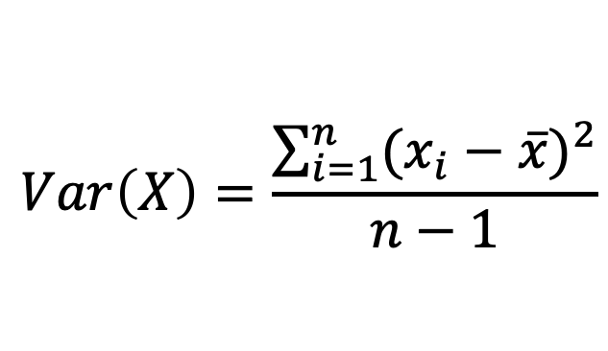
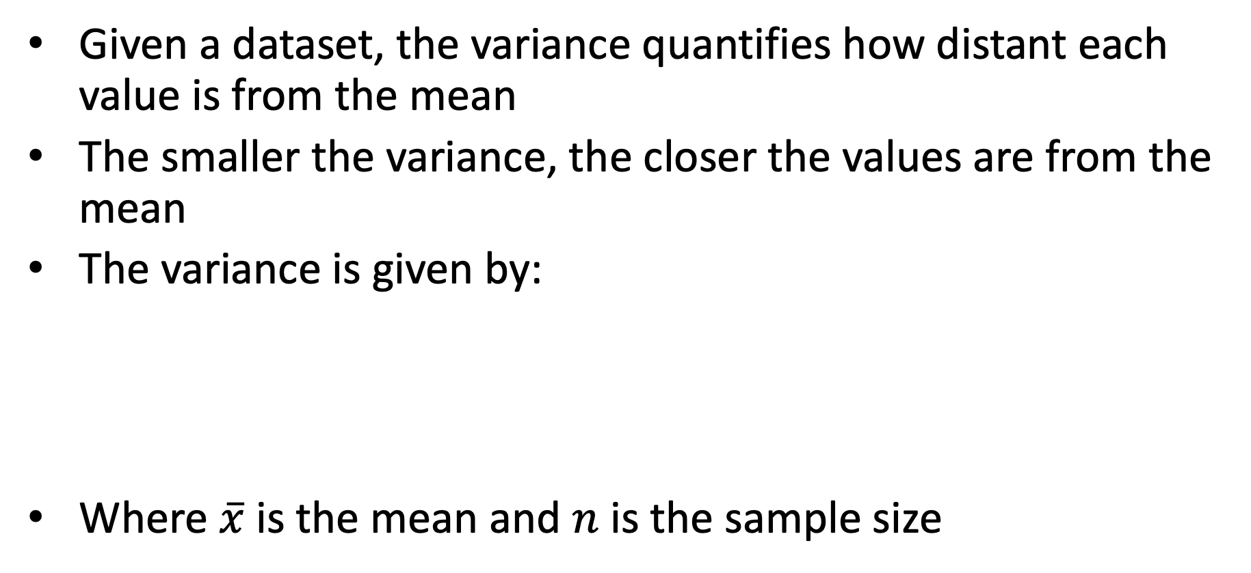
Variance
Given a dataset, the variance quantifies how distant each value is from the mean
The smaller the variance, the closer the values are from the mean
The variance is given by:
Where $\overline{x}$ is the mean and $n$ is the sample size
$$Var\left(X\right)=\frac{\sum_{i=1}^{n}{{(x_{i}−\overline{x})}^{2}}}{n−1}$$

Slide 22


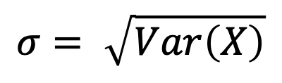
Standard deviation
The standard deviation provides an “error” rate of a dataset if the values are replaced by the mean
The standard deviation $σ$ is presented along with the mean:
The standard deviation is the square root of the variance
$$\overline{x}±σ$$
$$σ= \sqrt{Var\left(X\right)}$$

Slide 23
ANALYZING DISTRIBUTIONS

Slide 24
Assymetry
Compares the distribution to a gaussian distribution
When mean, median and mode match, the distribution is symmetric and the symmetry coefficient is zero
When the mean is greater than the median and mode, we have a positive assymetry
When the mean is smaller than the median and mode, we have negative assymetry

Slide 25
Kurtosis
Computes the “tailedness” of a distribution when compared to a gaussian distribution
A gaussian distribution has zero kurtosis and it is called mesokurtic
A distribution is positive kurtosis is said leptokurtic
A distribution with negative kurtosis is said platykurtic

Slide 27
Why is this important?
Many machine learning algorithms work under the assumption that data follows a gaussian distribution
Therefore, identifying extreme assymetry behavior requires data handling
We will study ways to handle this ☺

Slide 28
ACTIVITY

Slide 29
Salaries dataset
Let’s load the salaries dataset and uncover some statistics

Slide 30

LET’s PLAY A GAME

Slide 31
Your turn!
Let’s go to discord!
Each team will receive a number from 1 to 12
You should download the dataset and change X with your team’s number
df = pd.read_csv('http://www.ppgia.pucpr.br/~jean.barddal/datascience/anscombe/datasetX.csv’)
Use your pandas’ skills to analyze the data set and find out what is happening in the data

Slide 32
Anscombe Quartet
Same mean, variance, correlation and linear regression coefficients!
Therefore, summarization techniques are not enough!
Visualization is extremely important, as the actual behavior of data may differ
See the original paper:
F.J. Anscombe, "Graphs in Statistical Analysis," American Statistician, 27 (February 1973), 17-21.

Slide 33
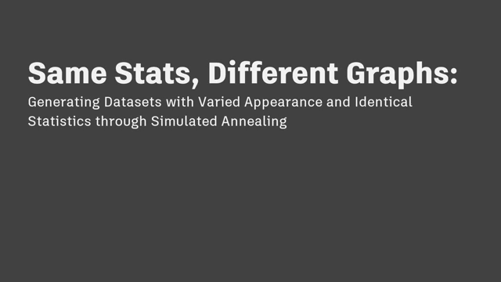
Same stats, different graphs

Slide 34
Take the remainder of the time to work on your project

